Slide 1
Programming fundamentals
Lecture 19: Pointers and arrays

Slide 2
Recap
Using Pointers
Dereferencing a pointer

Slide 3
Online lectures log
https://docs.google.com/spreadsheets/d/1LoI1nyp5jRlI-H1FTRFK8JS7saoNvNimhpueWdZFsMo/edit?usp=sharing

Slide 4
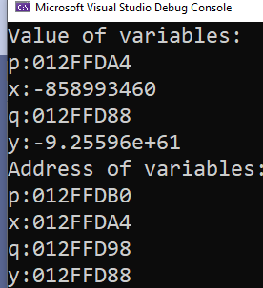
example
#include <iostream>
using namespace std;
int main()
{
int* p;
int x;
double *q;
double y;
p = &x;
q = &y;
cout << "Value of variables:" << endl;
cout << "p:" << p << endl;
cout << "x:" << x << endl;
cout << "q:" << q << endl;
cout << "y:" << y << endl;
cout << "Address of variables:" << endl;
cout << "p:" << &p << endl;
cout << "x:" << &x << endl;
cout << "q:" << &q << endl;
cout << "y:" << &y << endl;
return 0;
}
The addresses you see when you run the program may differ
from those shown here, but the net effect will be the same
Pointer p holding the address of variable x

Slide 5
* operator
Remember we used * while declaring pointer
We can also use * to extract/fetch the value pointed by the pointer. (also known as dereferencing)
#include <iostream>
using namespace std;
int main()
{
int* p; int x = 7;
p = &x;
cout << "Value present at the location pointed by p:" << *p << endl;
return 0;
}

Slide 6
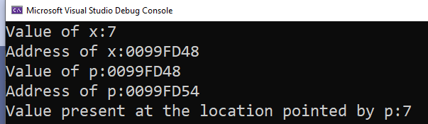
#include <iostream>
using namespace std;
int main()
{
int* p; int x = 7;
cout << "Value of x:" << x << endl;
cout << "Address of x:" << &x << endl;
p = &x;
cout << "Value of p:" << p << endl;
cout << "Address of p:" << &p << endl;
cout << "Value present at the location pointed by p:" << *p << endl;
return 0;
}
p
x
0099FD48
0099FD54
7
0099FD48

Slide 7
Assigning Values Through a Pointer
p = &x;
Pointer/address
address
#include <iostream>
using namespace std;
int main()
{
int* p; int x = 7;
int* q; int y = 9;
//while assigning value, make sure L.H.S matches with R.H.S
p = &x;
q = &y;
int* r, *s;
r = p;
s = q;
return 0;
}
r = p;
Pointer/address
Pointer/address
p
q
x
y
0FXY0
0FXX0
0FXY9
0FXX4
7
0FXY0
9
0FXY9
r
s
p
q
x
y
0FXY0
0FFF0
0FXY9
0FFF4
0FXY0
0FXX0
0FXY9
0FXX4
7
0FXY0
9
0FXY9

Slide 8
Change the value of variables indirectly using pointers
*p = 17;
value
value
#include <iostream>
using namespace std;
int main()
{
int* p; int x = 7;
int* q; int y = 9;
p = &x;
q = &y;
*p = 17;
*q = *q + 10;
return 0;
}
*q = *q+10;
value
value
p
q
x
y
0FXY0
0FXX0
0FXY9
0FXX4
7
0FXY0
9
0FXY9
p
q
x
y
0FXY0
0FXX0
0FXY9
0FXX4
17
0FXY0
19
0FXY9

Slide 9
Incrementing pointer vs incrementing value pointed by a pointer
#include <iostream>
using namespace std;
int main()
{
int* p; int x = 7;
p = &x;
cout << "p:" << p << endl;
cout << "*p:" << *p << endl;
cout << "&p:" << &p << endl;
cout << "&x:" << &x << endl;
(*p)++;
cout << "p:" << p << endl;
cout << "*p:" << *p << endl;
cout << "&p:" << &p << endl;
cout << "&x:" << &x << endl;
p++;
cout << "p:" << p << endl;
cout << "*p:" << *p << endl;
cout << "&p:" << &p << endl;
cout << "&x:" << &x << endl;
return 0;
}

Slide 10
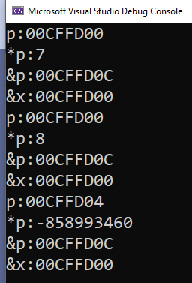
(*p)++ will indirectly print the value! p++ will increment in the contents of p (that is an address), therefore immediate next location (to variable x) address gets stored in p. Since its an int pointer therefore 4 bytes difference is there between consecutive locations.
#include <iostream>
using namespace std;
int main()
{
int* p; int x = 7;
p = &x;
cout << "p:" << p << endl;
cout << "*p:" << *p << endl;
cout << "&p:" << &p << endl;
cout << "&x:" << &x << endl;
(*p)++;
cout << "p:" << p << endl;
cout << "*p:" << *p << endl;
cout << "&p:" << &p << endl;
cout << "&x:" << &x << endl;
p++;
cout << "p:" << p << endl;
cout << "*p:" << *p << endl;
cout << "&p:" << &p << endl;
cout << "&x:" << &x << endl;
return 0;
}
x
00CFFD00 | 7
00CFFD04 | -858993460
00CFFD0C | 00CFFD00
p

Slide 11
Agenda
Pointers and arrays
Array of pointers

Slide 12
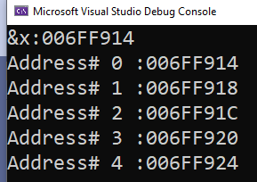
Print the address of 5 memory locations, immediate next to x
#include <iostream>
using namespace std;
int main()
{
int* p; int x = 7;
p = &x;
cout << "&x:" << &x << endl;
for (int i = 0; i < 5; i++)
cout << "Address# " << i << " :" << p++ << endl;
return 0;
}

Slide 13
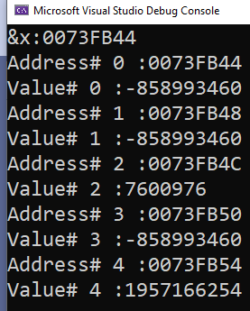
Print the address of 5 memory locations, immediate next to x and also print the values present at these locations
#include <iostream>
using namespace std;
int main()
{
int* p; int x = 7;
p = &x;
cout << "&x:" << &x << endl;
for (int i = 0; i < 5; i++)
{
cout << "Address# " << i << " :" << p++ << endl;
cout << "Value# " << i << " :" << *p << endl;
}
return 0;
}

Slide 14
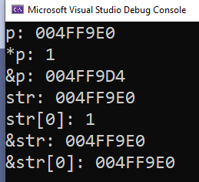
Pointers and Arrays
Since array’s name depicts base address therefore we can assign it to a pointer.
Provided that array type and pointer type matches
#include <iostream>
using namespace std;
int main()
{
int arr[4] = {1,2,3,4};
int* p;
p = arr;
cout << "p: " << p << endl;
cout << "*p: " << *p << endl;
cout << "&p: " << &p << endl;
cout << "str: " << arr << endl;
cout << "str[0]: " << arr[0] << endl;
cout << "&str: " << &arr << endl;
cout << "&str[0]: " << &arr[0] << endl;
return 0;
}

Slide 15
Accessing any element of an array with a pointer
p1 = str assigns the address of str[0] to p1
Since, after the assignment, p1 points to the beginning of str, you may use p1 to
access elements in the array. For example, if you want to access the fifth element in
str, you could use
str[4]
or
*(p1+4)
#include <iostream>
using namespace std;
int main()
{
char str[80];
char* p1;
p1 = str;
}
* ( p1+4 )
The parentheses surrounding p1+4 are necessary because the * operation has a higher priority than the + operation.
Without the parentheses, the expression would first find the value pointed to by p1 (the first location in the array) and then add 4 to it.
Value
Address

Slide 16
*p1+4
The parentheses surrounding p1+4 are necessary because the * operation has a higher priority than the + operation.
Without the parentheses, the expression would first find the value pointed to by p1 (the first location in the array) and then add 4 to it.
‘a’+4
98+4=101

Slide 17
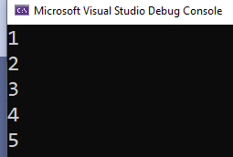
Iterating an array using pointer
p++
#include <iostream>
using namespace std;
int main()
{
int arr[5]= {1,2,3,4,5};
int* p;
p = arr;
for (int i = 0; i < 5; i++)
{
cout << *p << endl;
p++;
}
}

Slide 18
Iterating an array using pointer
*p++
Post increment
It will add first, ++ has highest precedence
#include <iostream>
using namespace std;
int main()
{
int arr[5]= {1,2,3,4,5};
int* p;
p = arr;
for (int i = 0; i < 5; i++)
{
cout << *p++ << endl;
}
}

Slide 19
Are Pointers and Arrays Interchangeable?
pointers and arrays are not completely interchangeable
#include <iostream>
using namespace std;
int main()
{
int num[10]; int* p;
int i;
p = num;
for (i = 0; i < 10; i++) {
p++; // this is OK
num++; // ERROR -- cannot modify num
}
}
You cannot increment base address by simply using array name. But, you can increment pointer

Slide 20
#include <iostream>
using namespace std;
int main()
{
int num[10]; int* p;
int i;
p = num;
for (i = 0; i < 10; i++) {
*num = i;// this is OK
num++; // ERROR -- cannot modify num
}
}
However, it is perfectly acceptable to apply the * operator to num
i.e. *num=I;

Slide 21
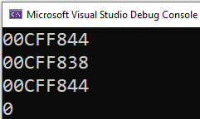
Arrays of Pointers
P[0]
P[1]
P[2]
00CFF838 | 00CFF888 | 00CFF788
00CFF844 | 00CFF848 | 00CFF852
#include <iostream>
using namespace std;
int main()
{
int* p[3];
int x = 0, y = 1, z = 2;
p[0] = &x;
p[1] = &y;
p[2] = &z;
cout << p << endl;
cout << p[0] << endl;
cout << &p[0] << endl;
cout << *p[0] << endl;
}
x
y
z
0
00CFF838
1
00CFF888
2
00CFF788

Slide 22
Multiple indirections
A pointer to a pointer is a form of multiple indirection, or a chain of pointers.
#include <iostream>
using namespace std;
int main()
{
int x, * p, ** q;
x = 10;
p = &x;
q = &p;
cout << *q; // prints the value of p
cout << **q; // prints the value of x
return 0;
}
x
p
q
10
0001
0001
00FFF
00FFF
00FE0
0001
10

Slide 23
Pointer initialization is must!
Just as we must make sure to initialize or define variables, the same applies to pointers
#include <iostream>
using namespace std;
int main()
{
int x, * p;
x = 10;
*p = x; // where does p point?
return 0;
}
ERROR

